Slide 1
Chapter 2: Intermediate JDBC

Slide 2
Learning Objectives
Intermediate JDBC:
Exception Handling and Cleanup
Working with Stored Procedures
Working with Database Functions
Connection Interface
Connecting with DriverManager
Executing PreparedStatement
Executing CallableStatement
Batch Operations with JDBC

Slide 3
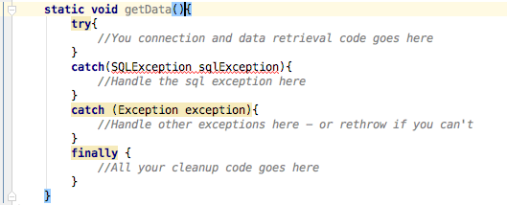
Exception Handling and Cleanup
Exception handling allows you to handle exceptional conditions such as program-defined errors in a controlled fashion.
When an exception condition occurs, an exception is thrown. The term thrown means that current program execution stops, and the control is redirected to the nearest applicable catch clause. If no applicable catch clause exists, then the program's execution ends.
JDBC Exception handling is very similar to the Java Exception handling but for JDBC, the most common exception you'll deal with is java.sql.SQLException.

Slide 4
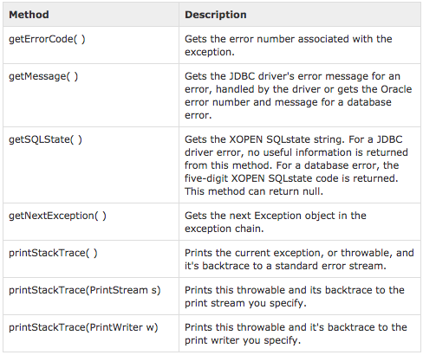
SQLException Methods

Slide 5
Examples: Chapter 2
See JDBC-Chapter2 (ExceptionHandling.java) at https://github.com/CompleteJavaTraining/AdvancedJava/tree/master/code/JDBC-Chapter2

Slide 6
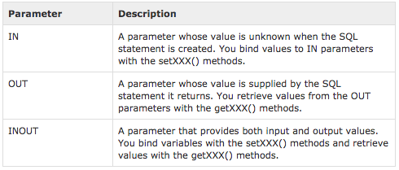
How To: Stored Procedures
We have learnt how to use Stored Procedures in JDBC in previous chapter.
Just as a Connection object creates the Statement objects, it also creates the CallableStatement object, which would be used to execute a call to a database stored procedure. All statements should be closed.
We can have parameters passed in to stored procedures and stored procedures can also return values back in parameters.
Three types of parameters exist: IN, OUT, and INOUT. The PreparedStatement object only uses the IN parameter. The CallableStatement object can use all the three.
Here are the definitions of each −

Slide 7
Examples: Chapter 2
See JDBC-Chapter2 (StoredProcedures.java) at https://github.com/CompleteJavaTraining/AdvancedJava/tree/master/code/JDBC-Chapter2

Slide 8
JDBC: Database Functions
Database functions let you find and perform calculations on specific pieces of data in a database. All of the database functions search a specified database for records that match specified criteria. Some of the database functions then perform calculations on data in a specified field of the matching records.
You can use callable statement to execute the functions as well in the database.
Advantages of using stored function:
Increases the performance, as these are pre-compiled
Faster execution
Business logic completely inside database with extra-level of security
If there are any changes in business logic, all changes need to be done at database end and not making Java code dirty

Slide 9
Examples: Chapter 2
See JDBC-Chapter2 (DatabaseFunctions.java) at https://github.com/CompleteJavaTraining/AdvancedJava/tree/master/code/JDBC-Chapter2

Slide 10
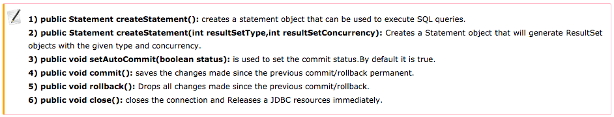
JDBC: More About Connection
A Connection is the session between java application and database. The Connection interface is a factory of Statement, PreparedStatement, and DatabaseMetaData i.e. object of Connection can be used to get the object of Statement and DatabaseMetaData. The Connection interface provide many methods for transaction management like commit(), rollback() etc.
By default connection commits the changes (more on this later)
Commonly Used Methods:

Slide 11
Establishing a Connection with DriverManager
DriverManager is fully implemented class connects an application to a data source, which is specified by a database URL. When this class first attempts to establish a connection, it automatically loads any JDBC 4.0 drivers found within the class path.
Note: Your application must manually load any JDBC drivers prior to version 4.0.
Connecting to your DBMS with the DriverManager class involves calling the method DriverManager.getConnection.
This method requires a database URL, which varies depending on your DBMS.
The following are some examples of database URLs:
MySQL: jdbc:mysql://localhost:3306/, where localhost is the name of the server hosting your database, and 3306 is the port number
Java DB: jdbc:derby:testdb;create=true, where testdb is the name of the database to connect to, and create=true instructs the DBMS to create the database.
Note: This URL establishes a database connection with the Java DB Embedded Driver. Java DB also includes a Network Client Driver, which uses a different URL.
This method specifies the user name and password required to access the DBMS with a Properties object.

Slide 12
Examples: Chapter 2
See JDBC-Chapter2 (DriverManager.java) at https://github.com/CompleteJavaTraining/AdvancedJava/tree/master/code/JDBC-Chapter2

Slide 13
PreparedStatements: Overview
Sometimes it is more convenient to use a PreparedStatement object for sending SQL statements to the database. This special type of statement is derived from the more general class, Statement, that you already know.
If you want to execute a Statement object many times, it usually reduces execution time to use a PreparedStatement object instead.
The main feature of a PreparedStatement object is that, unlike a Statement object, it is given a SQL statement when it is created. The advantage to this is that in most cases, this SQL statement is sent to the DBMS right away, where it is compiled. As a result, the PreparedStatement object contains not just a SQL statement, but a SQL statement that has been precompiled. This means that when the PreparedStatement is executed, the DBMS can just run the PreparedStatement SQL statement without having to compile it first.
Although PreparedStatement objects can be used for SQL statements with no parameters, you probably use them most often for SQL statements that take parameters. The advantage of using SQL statements that take parameters is that you can use the same statement and supply it with different values each time you execute it.

Slide 14
Examples: Chapter 2
See JDBC-Chapter2 (PreparedStatements.java) at https://github.com/CompleteJavaTraining/AdvancedJava/tree/master/code/JDBC-Chapter2

Slide 15
Batch Processing
Batch Processing allows you to group related SQL statements into a batch and submit them with one call to the database.
When you send several SQL statements to the database at once, you reduce the amount of communication overhead, thereby improving performance.
Not all drivers support batch processing, use DatabaseMetaData.supportsBatchUpdates(). It returns true if the driver supports batch processing.

Slide 16
Batch Processing - Steps
1. Get connection
2. Set autocommit to false so that we can commit all the batch updates at once (to avoid partial inserts if there is some error)
3. Get a callable statement - this could be a normal text statement as well (i.e. prepared statement)
4. Run a simple loop to add batched values to the statement
5. finally execute the batch statements
6. Commit all the batch operations (important - if you do not commit the changes would not be persisted.
7. Perform cleanup.
8. Now show how many records are inserted - Notice the use of IntStream (it converts a collection into a stream and then we can perform map reduce operations on it).

Slide 17
Examples: Chapter 2
See JDBC-Chapter2 (BatchProcessing.java) at https://github.com/CompleteJavaTraining/AdvancedJava/tree/master/code/JDBC-Chapter2

Slide 18
What are we learning in Next Chapter ?
You will learn about Advanced JDBC
We will learn about:
RowSet
CachedRowSet
Connection Pooling (using javax.sql.DataSource interface)
Transactions , Commits, Rollbacks
Transaction Isolation Levels
BLOB
CLOB

Slide 19
Thank You !

